Slide 1
Board Game Development Environment
Colin Theriac – Project Manager, Environment Developer
AbiGail Westfall – Environment Developer, Lead Programmer
Nathan Bashor – Checkers Game Developer
Aaron Johnston – Checkers Game Developer
Hayden Woodbrey – Connect 4 Developer
Michael Spaulding – Connect 4 Developer

Slide 2

Original Vison
The Task to be Undertaken
Most games have at their core some universal mechanics and entities that they all share. Of those, the interoperability of the game pieces and the environment is the most important. Our goal is to create this mechanic as a base state, and an environment that will allow programmers to use our code for the generation of full games.
(From Initial Feasibility)

Slide 3
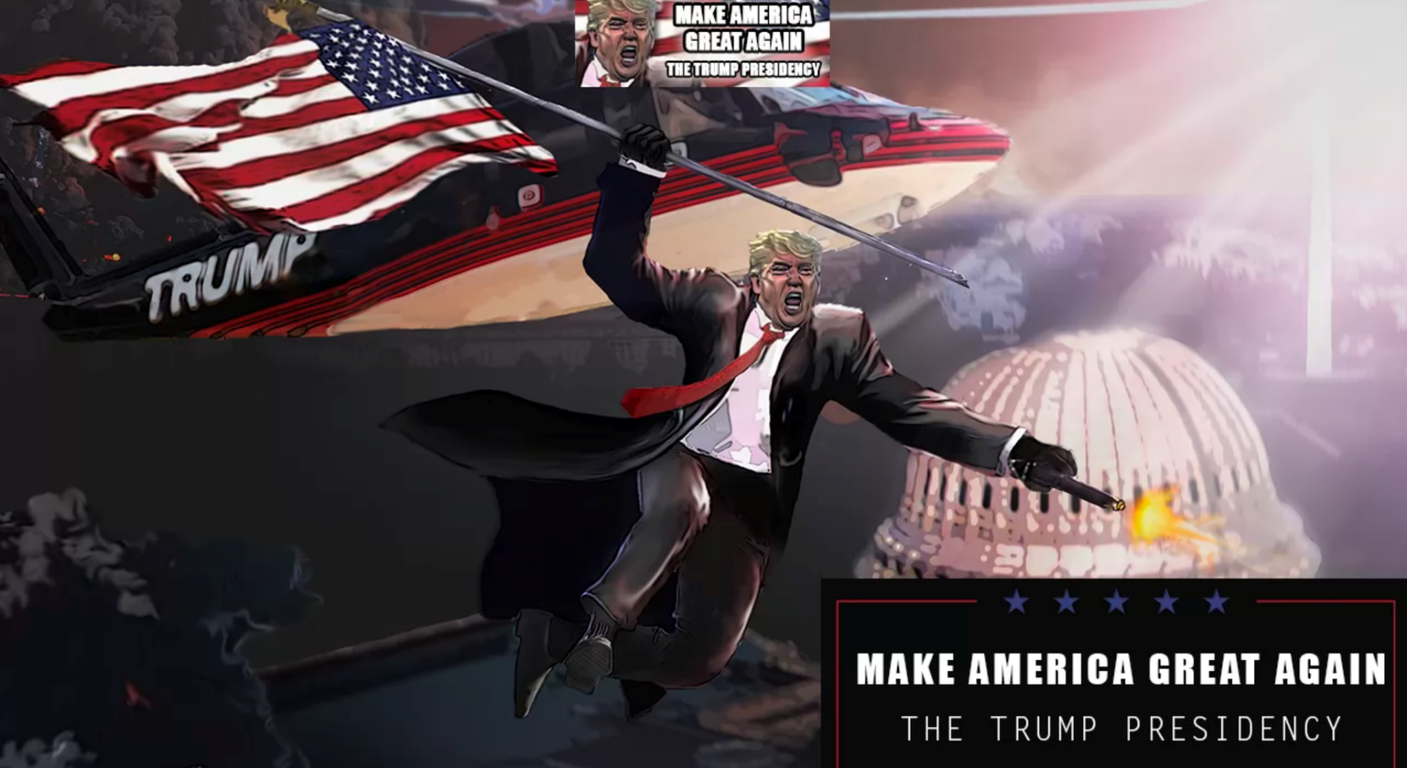
Example of use in business applications

Slide 4
What we created for Version 1.0
1889 lines of code
Fully Interactive environment for creating board characteristics
Movable Units with customization
Ability to save and load the user’s work
Button to integrate user defined game mechanics
Fully Functioning Checkers Game as proof of concept

Slide 5

Our Story: Challenges Along the Way
Original Version and the implementation of the “Panel” Object
Explosion of development
Units holdup
Save and Load development
Short time for Game development
Difficulties implementing game rules due to limitations created in the development environment
Endless Feature Creep

Slide 6
Code review and demonstration
Checklist to show:
Showing UI
Create Board with multiple features
Add specialized units
Add connections for future game mechanics
Save our work
Load Checkers Game
Add user defined game mechanics
Play Checkers

Slide 7

Future Versions
Ability to point adjust created tiles
Ability to use intricate shapes for units
Ability to make the user code during runtime with a compiler
More premade game rules with more ease of integration
Automatic reset and play mode separation
Publish game outside of development environment
Further Overhaul to make code more modular
Mechanics for creating turn based movement

Slide 8
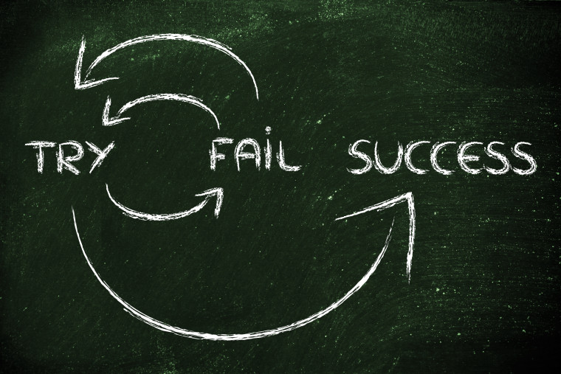
Lessons learned
Project management and task specialization and parallelization
The importance of Code Review
Experience and mastery in C#
Experience using GitHub

Slide 9
Questions, comments, concerns, threats, or protestations?

